Slide 1
District Grant Awards
2016

Slide 2
District 6200 Programs
Annual Interact Convention - $4000
Global Scholar Orientation - $850
Vocational Training Team D4250 - $7489
Youth Exchange program - $2000
RYLA expenses - $5000
Administration expenses - $1500
Contingency Fund - $7000

Slide 3
District Grant Applications
Total grants received ----25
Total grants awarded----18
Total amount requested----$60195
Total amount awarded----$35829
Grants receiving partial funding----6

Slide 4
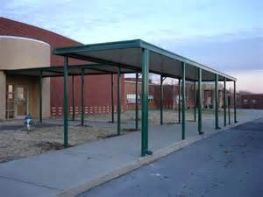
Abbeville
Ramp and Awning Project
Requested $5634.49
Awarded $3935.00
Application complete – Max is $5K award and scaled down project resulted in $3935 award

Slide 5
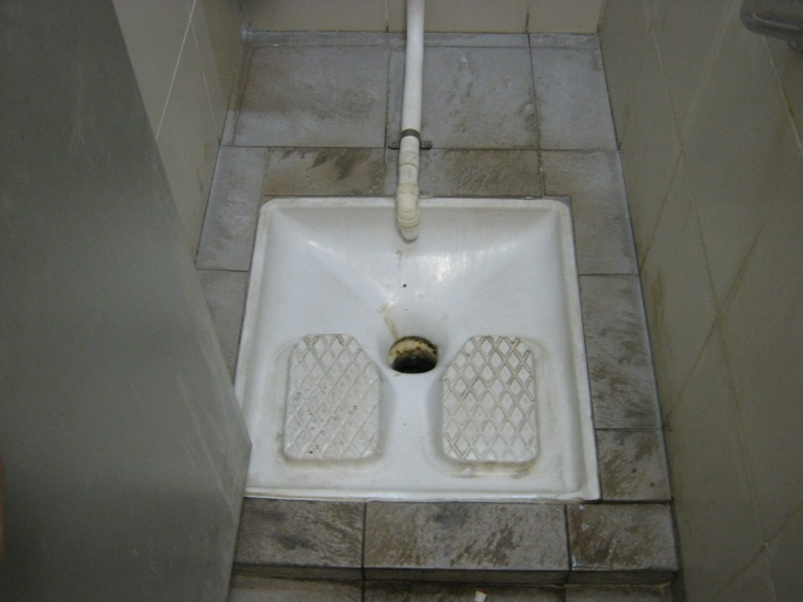
Baker #1
Installation of toilets (India)
Requested $2200
Awarded 0
District Grant sought to help fund a Global Grant – Funds from one grant type cannot assist another grant

Slide 6
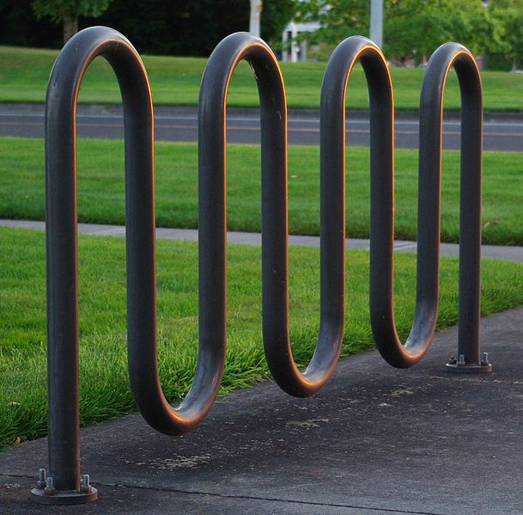
Baker #2
Bike Racks
Requested $550
Awarded $550
Complete application – no issues

Slide 7
Baker # 3
Fire Safety Education at Schools
Requested $400
Awarded $400
Complete application – no issues

Slide 8
Baton Rouge
Provide Health Materials
Requested $3000
Awarded $3000
One for one match according to per capita giving
Club awarded $3K contingent with club also donating #3k

Slide 9
Baton Rouge Capital City #1
Computers and Instructions
Requested $5000
Awarded $5000
Complete application – no issues

Slide 10
Baton Rouge Capital City #2
Furnish and erect fencing (Swaziland)
Requested $5000
Awarded 0
Large project – could best fit a Global Grant

Slide 11
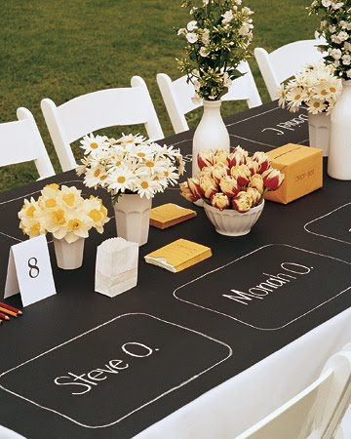
Baton Rouge Capital City #3
Rent Equipment for Event
Requested $3375
Awarded 0
Ongoing project, don’t fund rental fees for goods

Slide 12
Crowley #1
Purchase books for education
Requested $729.60
Awarded $730.00
Complete Application – No issues (rounded up)

Slide 13
Crowley #2
Provide Pavilion for Park
Requested $580
Awarded $580
Complete Application – No issues

Slide 14
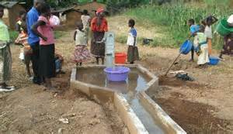
Crowley #3
Purchase Water Wells
(Malawi)
Requested $600
Awarded $0
Incomplete application – insufficient documentation
No pro forma invoice , no bid process

Slide 15
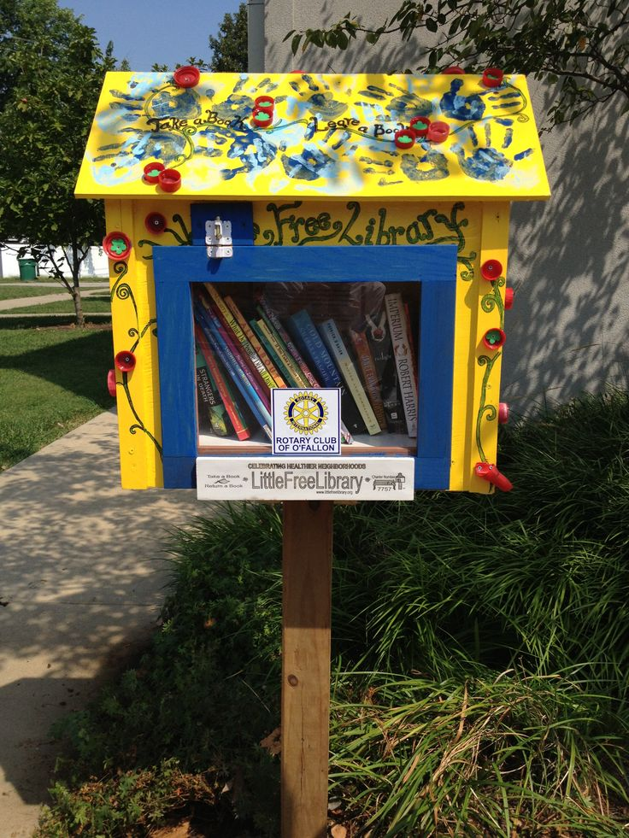
East Ascension
Build and install book shelves and purchase books for mini libraries
Requested $1602
Awarded $600
Partial funding based on per capita giving

Slide 16
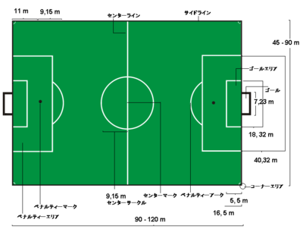
Golden Meadow #1
Provide a soccer/practice field
Requested $3694
Awarded $3500
Complete application – no issues
Amount awarded reduced – multiple applications

Slide 17
Golden Meadow #2
Provide food, hygiene items, and cleaning materials to at risk families
Requested $2000
Awarded $1500
Complete application – not all expenses eligible

Slide 18
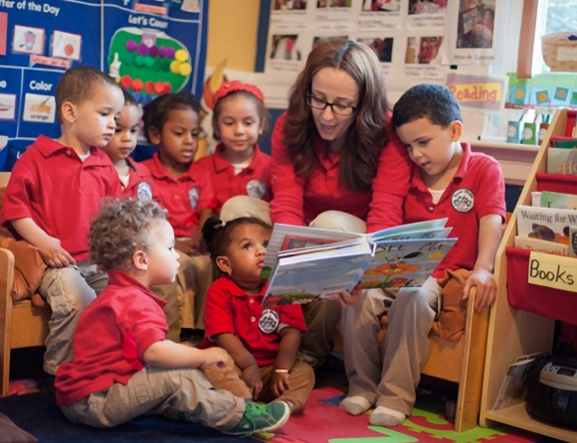
Gonzales
Volunteer at school
Requested $1040
Awarded $1040
Complete application – no issues

Slide 19
Lafayette North
Academic Rewards Program
Requested $2666
Awarded $2666
Complete application – no issues

Slide 20
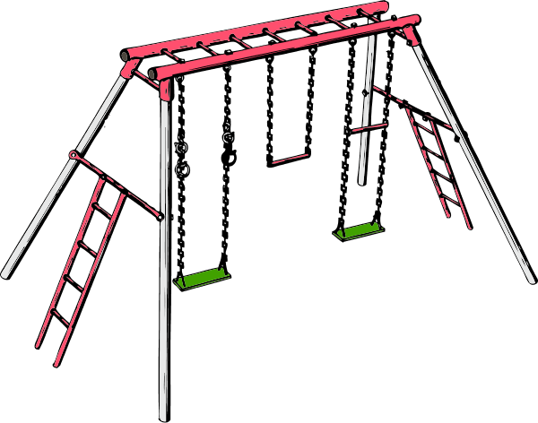
Livingston Parish
Park swing sets
Requested $2700
Awarded $2700
Complete application – no issues

Slide 21
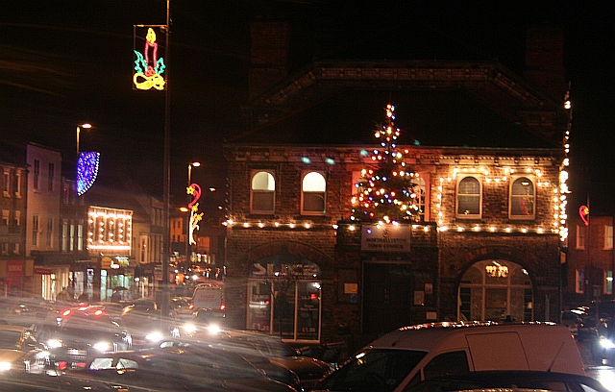
Lockport
Provide holiday decorations
Requested $5000
Awarded 0
Did not meet the requirements of per capita giving
Only good for a few weeks during the year

Slide 22
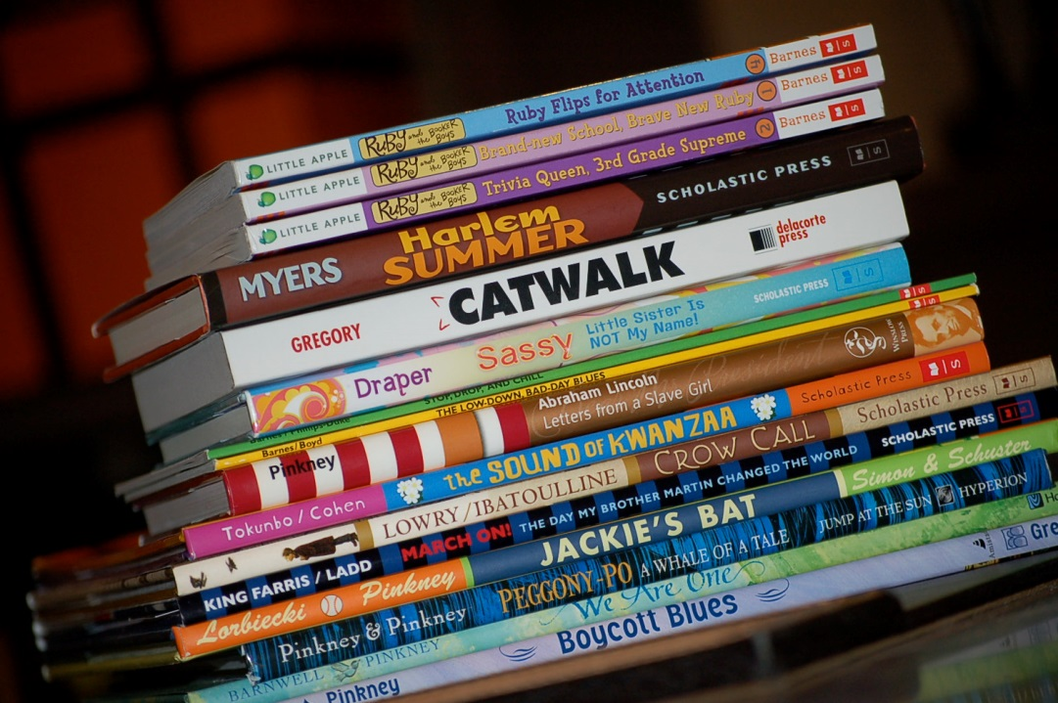
Morgan City #1
Purchase books to read to children
Requested $2000
Awarded $1870
Complete application – Advertising not allowed

Slide 23
Morgan City #2
Environmental Education Program
Requested $1341
Awarded $1341
Complete application – no issues

Slide 24
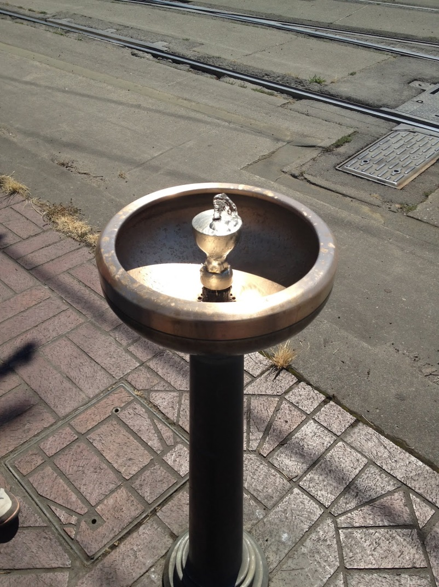
Opelousas Sunrise #1
Signage, bike rack, water fountain
Requested $4000
Awarded $4000
Complete application – no issues

Slide 25
Opelousas Sunrise #2
School gym weights
Requested $4000
Awarded $0
Many factors including inconclusive budget, liability
questions and school board issue, etc..

Slide 26
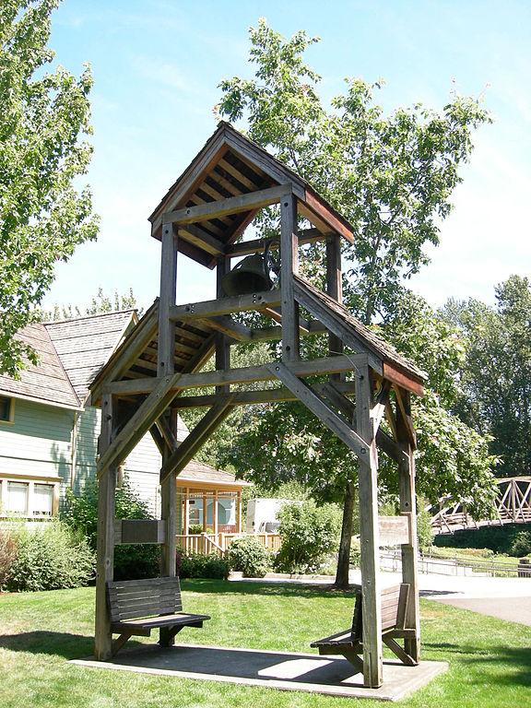
Welsh #1
Construct bell tower
Requested $2500
Awarded $0
Per capita giving limited match, inconclusive budget
New construction

Slide 27
Welsh #2
Cleaning supplies
Requested $333
Awarded $167
Per capita giving limited match

Slide 28
Zachary
Train Depot rehabilitation
Requested $2250
Awarded $2250
Complete application – no issues

Slide 29
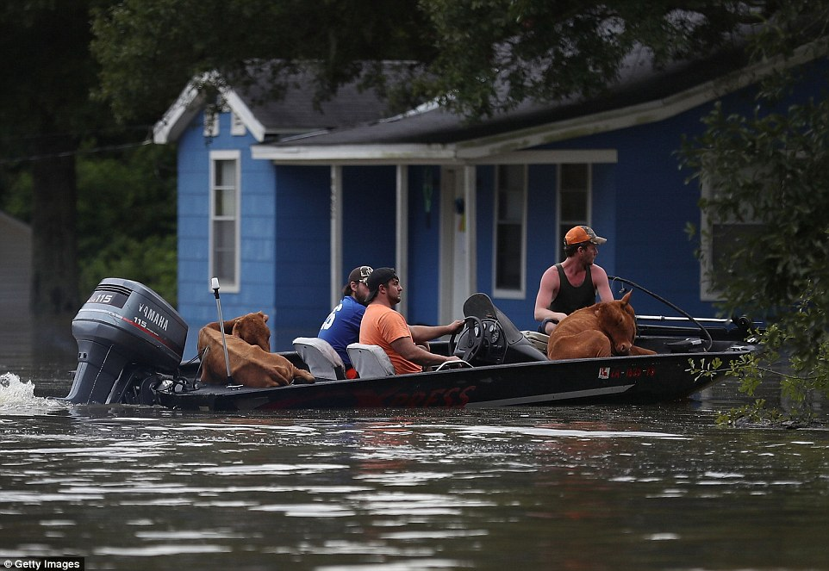
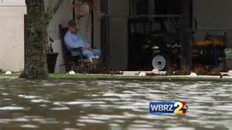
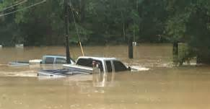
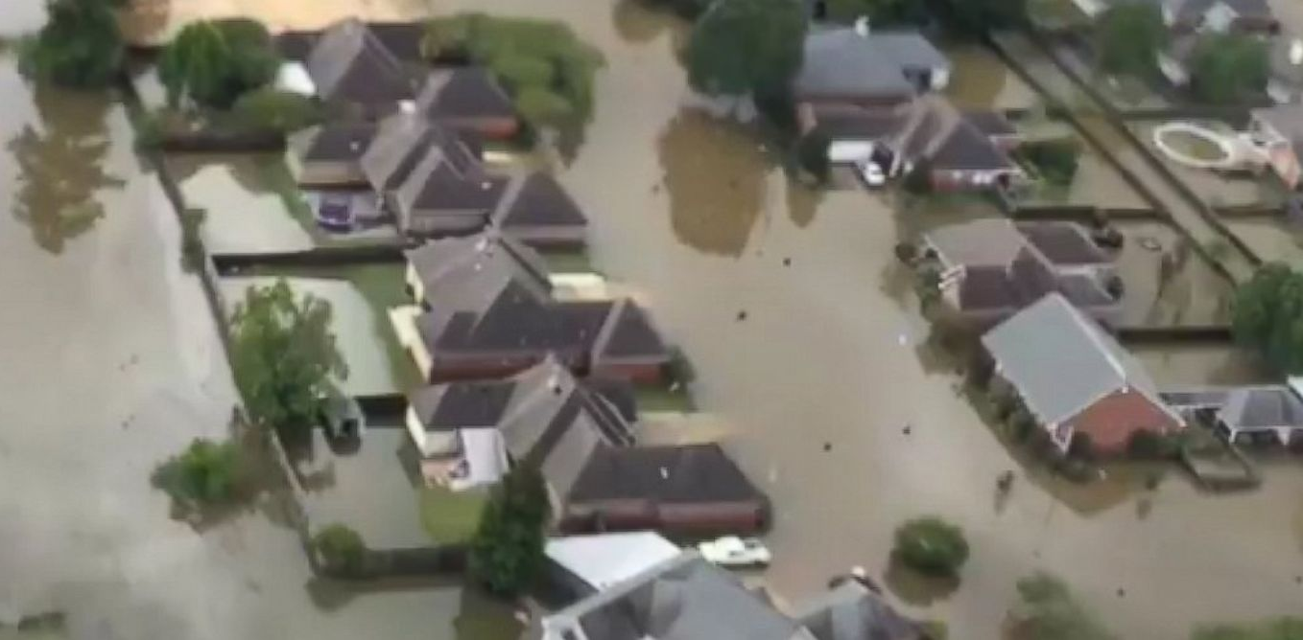
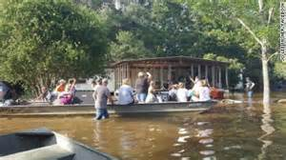

Slide 30
Livingston
September 22, 2016

Slide 31
St. Amant
September 22,2016

Slide 32
St. Amant
September 22, 2016

Slide 33
Baker
September 22, 2016

